Slide 1
Exploring Cryptography Protocols
with Limited Emphasis on Mathematics ☺
Presented By
@7eRoM

Slide 2
Attention
These slides have been crafted using the foundation of my MSc course in Cryptography Protocols at the University of ISfahan.
I've made adjustments to the content to align with the specific objectives of this presentation.
Also, My intention has been to minimize the use of mathematical concepts, which may result in some concepts being simplified or less precise.
Presented By
@7eRoM

Slide 3
Agenda
Identification and Entity Authentications Protocols
Zero Knowledge Protocols
Key Establishment Protocols
Threshold Cryptography and Secret Sharing Protocols
Special Purpose Protocols (like simultaneous contract signing, mental poker, fair exchange)
Identity Based Cryptography
Types of Digital Signatures
Secure Multiparty Computations

Slide 4
Levels of Authentications
Weak Authentication (based on password)
Strong Authentication (based on challenge and response)
Extremely Strong Authentication (based on zero knowledge)

Slide 5
Extremely Strong Authentication
Zero Knowledge
Refers to a protocol or proof in which one party, called the prover, can demonstrate knowledge of a certain piece of information to another party, called the verifier, without revealing any additional information beyond the validity of the statement.

Slide 6
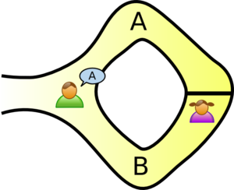
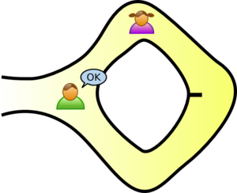
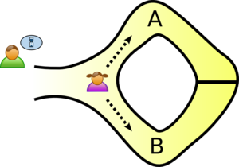
Extremely Strong Authentication
Alibaba Cave
Peggy has the secret word used to open a magic door.
Peggy randomly takes either path A or B, while Victor waits outside
Victor enters the cave and shouts the name of the path he wants her to use to return, either A or B, chosen at random
Peggy reliably appears at the exit Victor names.
If Peggy repeatedly do that, he can conclude that it is extremely probable that Peggy know the secret word.

Slide 7
Extremely Strong Authentication
Alibaba Cave
suppose she did not know the word
she would only be able to return by the named path if Victor were to give the name of the same path by which she had entered
Victor would choose A or B at random, she would have a 50% chance of guessing correctly.
If they were to repeat this trick many times:
The chance: (1/2) * (1/2) * ... * (1/2) = (1/2)^{n} ≈ 0

Slide 8


Extremely Strong Authentication
Two balls and the color-blind friend
Alice is prover and not color-blind.
Bob is verifier and color-blind.
Alice wants to prove has two identical but different color balls but not want to reveal which ball is the red one and which is the green.
Alice gives the balls to Bob.
For multiple times:
Bob swaps the balls without Alice knowing.
Choose one of them and shows to Alice
Alice says it is same as the previous or is a different one
?

Slide 9
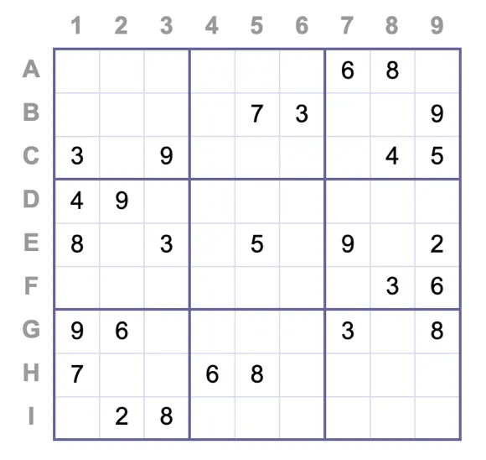
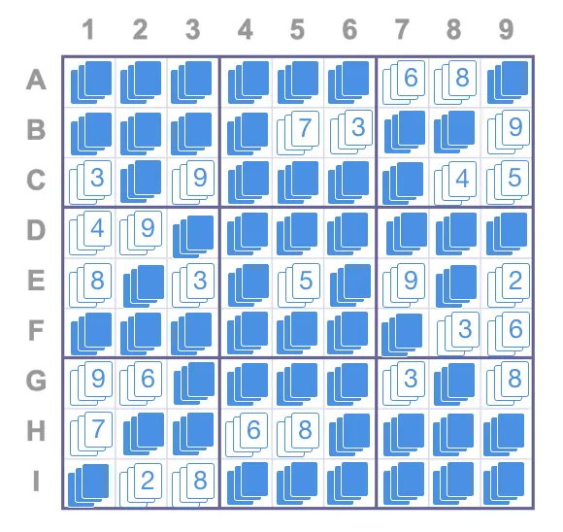

Extremely Strong Authentication
Sudoku
Bob can request each arbitrary row/column/subgroup.
The card would be shuffled before giving back to Bob.
Bob flips the cards over and verifies the numbers 1 through 9 without any numbers missing or duplicated.
Alice wants to prove to Bob that she has solved a Sudoku puzzle.
For each cell, Alice places 3 cards with the corresponding number. For a cell with an existing value, the cards are faced up. For the rest, they are faced down.

Slide 10
Extremely Strong Authentication
Fiat-Shamir identification protocol
Theorem
N=pq (p and q are large prime number)
r² mod N
Finding r is hard-problem

Slide 11
Extremely Strong Authentication
Fiat-Shamir identification protocol
commitment
x=r² mod N
secret S
private r
public N
public x=r² mod N
public v=S² mod N
challenge
e=0 or e=1
Verification:
y² = xv^{e} mod N
response
?
y=rS^{e} mod N

Slide 12
Extremely Strong Authentication
Fiat-Shamir identification protocol
commitment
x=r² mod N 70
secret S 101
private r 42
public N 7*11=77
public x=r² mod N 70
public v=S² mod N 37
challenge
e=0 or e=1
Verification:
y² = xv^{e} mod N
70 = 70 * 1
49 = 70 * 37
response
?
y=rS^{e} mod N 42 or 7

Slide 13

Extremely Strong Authentication
Fiat-Shamir identification protocol
x=r² mod N
Trudy guesses Bob sends e=0
e=0
y=r mod N
x=r²v⁻¹ mod N
Trudy guesses Bob sends e=1
e=1
y=r mod N
Because Trudy does not know challenge e, his chance is almost zero like Alibaba cave.
If Trudy can find r in r² mod N, he can easily find the secret S!

Slide 14
Extremely Strong Authentication
Feige-Fiat-Shamir identification protocol
commitment
x=r² mod N
n secrets S₁,S₂,...,S_{n}
private r
public N
public x=r² mod N
public v_{i}=S_{i}² mod N
challenge
e₁,e₂,...,e_{n}
Verification:
y² = xv₁^{e1}v₂^{e2}... v_{n}^{en} mod N
response
?
y=rS₁^{e1}S₂^{e2}... S_{n}^{en} mod N

Slide 15
Extremely Strong Authentication
Discrete Logarithm Problem (DLP)
Theorem
a finite cyclic group G
with a generator g
with a large prime modulo p
x = g^{h} mod p
For a given x, Finding h is hard-problem

Slide 16
Extremely Strong Authentication
Some Terms: generator
is an element that generates the entire group when raised to different powers.
Example:
a multiplicative group Z*₇
elements of the group: {1,2,3,4,5,6}
‘3’ is a generator
3¹ mod 7 = 3
3² mod 7 = 2
3³ mod 7 = 6
3⁴ mod 7 = 4
3⁵ mod 7 = 5
3⁶ mod 7 = 1

Slide 17
Extremely Strong Authentication
Some Terms: order of element
refers to the smallest positive integer n such that raising the element g to the power of n yields the identity element of the group. (ord(g) = n)
Example:
a multiplicative group Z*₁₁
elements of the group: {1,2,3,4,5,6,7,8,9,10}
ord(3) = 5
3¹ mod 11 = 3
3² mod 11 = 9
3³ mod 11 = 5
3⁴ mod 11 = 4
3⁵ mod 11 = 1

Slide 18
Extremely Strong Authentication
Some Terms: order of group
The number of elements contains
Example:
a multiplicative group Z*₁₁
elements of the group: {1,2,3,4,5,6,7,8,9,10}
order: 10

Slide 19
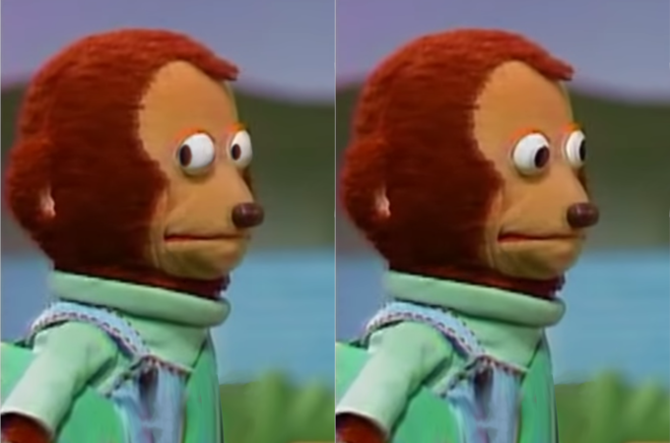
The presentation avoids using too many mathematical concepts.
Me

Slide 20
Extremely Strong Authentication
Schnorr
setup:
Public key A=gª mod p Private key a is random from range [0,q-1]
q | p-1
commitment
c=g^{v} mod p
agreement on:
cyclic group G of prime order q,
with a generator g
agreement on:
cyclic group G of prime order q,
with a generator g
challenge
e from range [0,2^{t}-1]
Verification:
g^{y} = c * A^{e} mod p
Private random v from range [0,q-1]
response
?
y=v+a*e mod q

Slide 21
Ref
Cryptography Protocols Course, Dr. Hamid Mala, University of Isfahan
https://datatracker.ietf.org/doc/html/rfc8235
https://blog.goodaudience.com/understanding-zero-knowledge-proofs-through-simple-examples-df673f796d99
https://en.wikipedia.org/wiki/Zero-knowledge_proof#Definition
https://www.iconfinder.com/UsersInsights
https://www.iconfinder.com/Chanut-is

